Slide 1
Git/GitHub and CDNs

Slide 2

Submit Homework
Make sure you submitted your Invision URL on Canvas

Slide 3
Last Week Review
Working with Invision
Advanced CSS
Rounded Corners
Box Shadows
Transitions

Slide 4
This week overview
CDNS
What are they
How to use them
Git and GitHub
Create New Final Directory
Use GitHub Desktop
Start Using GitHub

Slide 5
CDNs

Slide 6
CDN: What & Why
CDN stands for “content delivery network” or “content distribution network”
A CDN allows for the quick transfer of assets needed for loading Internet content including HTML pages, JavaScript Files, Stylesheets, images, and videos
“CDN nodes are usually deployed in multiple locations, often over multiple backbones, Benefits include reducing bandwidth costs, improving page load times, or increasing global availability of content”.

Slide 7
CDN: When will we use them?
CDN are vastly important and one way you can implement them is within your own projects.
For example let’s take a look at Twitter Bootstrap
Twitter Bootstrap is/was an extremely popular framework for building Responsive Frontend websites and application.
Let’s build a page that brings in Twitter Bootstrap to demonstrate how you might do this without the assistance of a CDN

Slide 8
CDN: Demonstrate Twitter Bootstrap (TWBS)
Open class-directory
Create bootstrap.html file
Download Twitter Bootstrap
Unzip bootstrap-3.3.7-dist
The reason we aren’t using Bootstrap 4 for this is because it doesn’t come bundled with fonts by default
Place the assets
bootstrap-3.3.7-dist/css/bootstrap.min.css >>> class-directory/assets/css
Don’t worry about JavaScript files
bootstrap-3.3.7-dist/fonts/* >>> class-directory/assets/fonts
The * means all the files
On Twitter Bootstrap site visit Components and paste in some examples

Slide 9
CDN: Manual file placement
With that example we had to manually go out to
Go to the website
Download the files
Unpack the files
Place the asset files
Code
That isn’t a ton of work in this example but what if
You had to do this for 30 different tools, plugins, etc.?
You are serving files from your server say in the US. What if your user is in China?

Slide 10


Slide 11
CDN: How do we implement?
Staying in class-directory
Create a new file bootstrap-cdn.html
Navigate to Twitter Boostrap “Getting Started”
Copy the first CDN link for CSS
Paste that link inside your HTML file in the <head>
Now in the <body> copy all the elements you had from bootstrap.html

Slide 12

CDN: FTW
As you can see with a single line of html and the power of CDN you
Go to the website
Download the files
Unpack the files
Place the asset files
Code

Slide 13
CDN: Loading Fonts
Custom fonts are a popular and fun way to make your website unique and give your site a bunch of personality
Many popular sites like
DaFont
FontSpace
Are great places to download and use custom fonts
For this demonstration we are going to load in a custom Google Fonts
Google Fonts is a great site to get amazing professional looking fonts simply and easily for any project

Slide 14
CDN: Manual loading of fonts
Open class-directory
Create a new html file called fonts.html
Go to Google Fonts and download a font
Unzip the file of the font you selected
Take that font file and place inside of class-directory/assets/fonts
Create a fonts.css file inside of class-directory/assets/stylesheets
Inside the CSS file link up @font-face rule for your downloaded font
Back to fonts.html link up fonts.css
Test

Slide 15


Slide 16
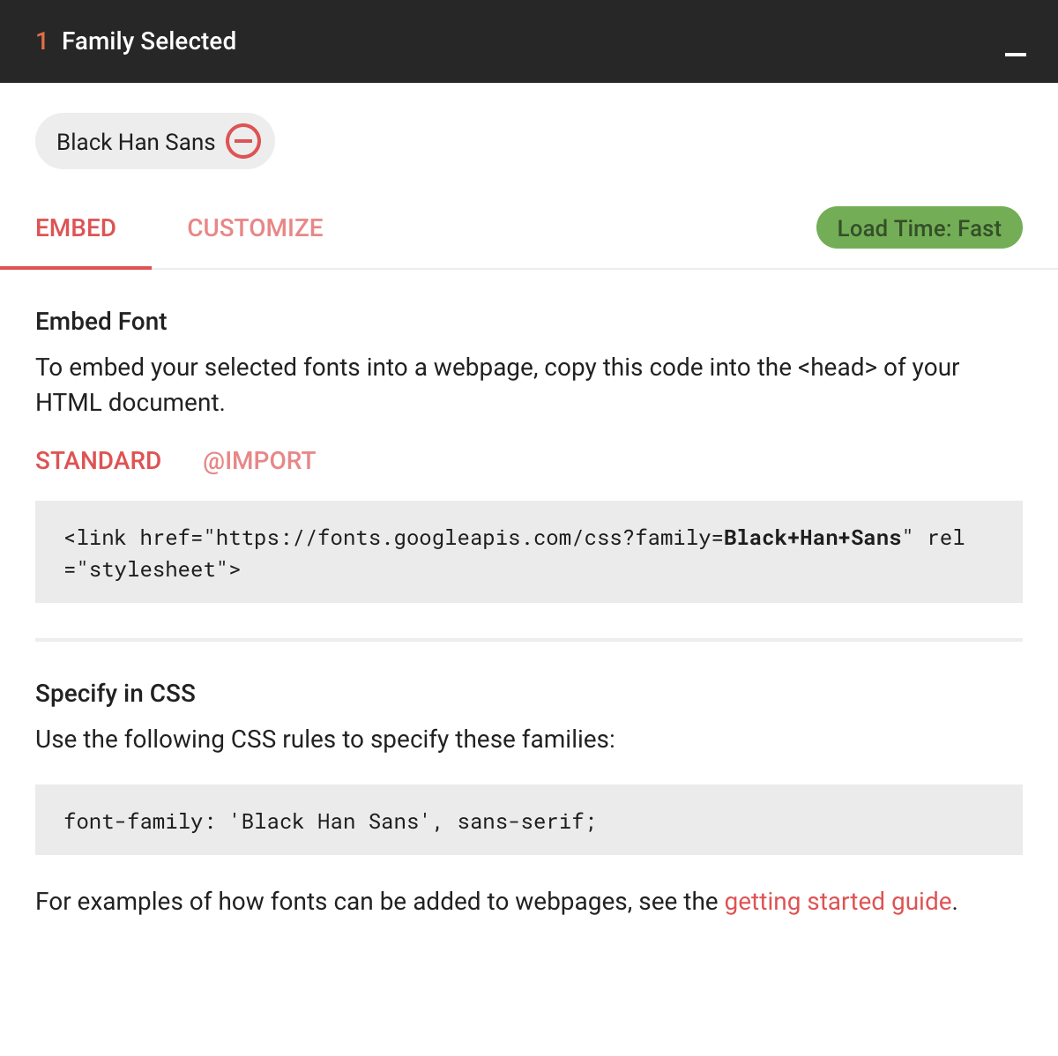
CDN: Load fonts by CDN
Create a file called fonts-cdn.html
Go back go Google Fonts
Select the font you had prior
Highlight the <link .../>
Paste link in <head> of your HTML file
Create a new CSS file
assets/stylesheets/fonts-cdn.css
Create a CSS rule and paste in the font family
View your code in the browser

Slide 17
CDN: Recap
Content delivery networks are the transparent backbone of the Internet in charge of content delivery
No matter what you do or what type of content you consume chances are it is being powered by some type of CDN
CDNs minimize the distance between users locations and the web servers allow for better performance
Spreads out your content so it is not in a single location

Slide 18
Git & GitHub

Slide 19

Git & GitHub
Git & GitHub have been brought up on multiple occasions and it may not have sunk in yet what is being talked about
Git = Version Control
GitHub = Platform that uses Git

Slide 20

What is Git?
“Git is a free and open source distributed version control system designed to handle everything from small to very large projects with speed and efficiency” - git
Git is a Version Control System
Version control is a system that records changes to a file or set of files over time so you can recall specific version later

Slide 21


Slide 22
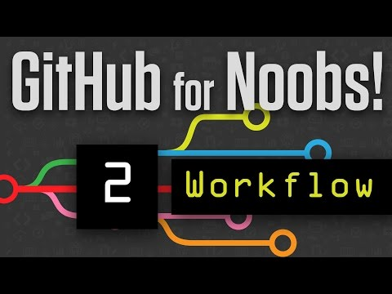

Slide 23


Furthering Git and GitHub knowledge

Slide 24
Deploy Site Using GitHub Desktop

Slide 25
Preface
My workflow is a bit different than what will be demonstrated in this lecture. I do not use GitHub desktop professionally. However, that doesn’t mean it is not an acceptable tool to use in professional or personal environment. Tools are meant to get a job done and at the end of the day that’s all that matters is the job gets done.
Because of this you may find differing material and resources online. All that is completely acceptable to follow if it works for you or others.
Good YouTube Series:
Getting Started With GitHub Part 1
Getting Started With GitHub Part 2
Getting Started With GitHub Part 3

Slide 26

What is GitHub Desktop?
GitHub Desktop is a Graphical User Interface for interacting with GitHub
Available on MacOS and Windows
Designed by the folks at GitHub
Free

Slide 27
Installing GitHub Desktop
Download GitHub Desktop
Install GitHub Desktop (locate GitHubDesktop.zip on your file system)
Once installed you will be prompted to enter your GitHub.com credentials
Step through the rest of the steps, you may receive an e-mail a 3rd party app has authorized your account

Slide 28
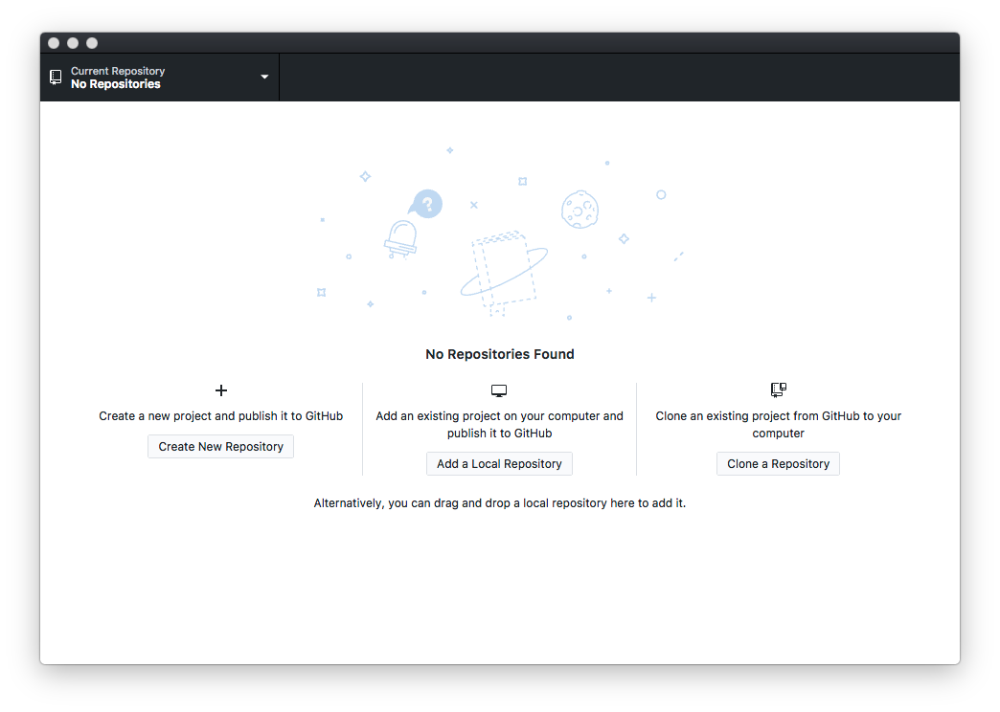
Setting up your first Repo
Create a new project and publish?
You don’t have Git files in your project
Add an existing project and publish?
You have Git files in your project
Clone an existing project from GitHub?
There’s code already on GitHub you want to download and work on

Slide 29
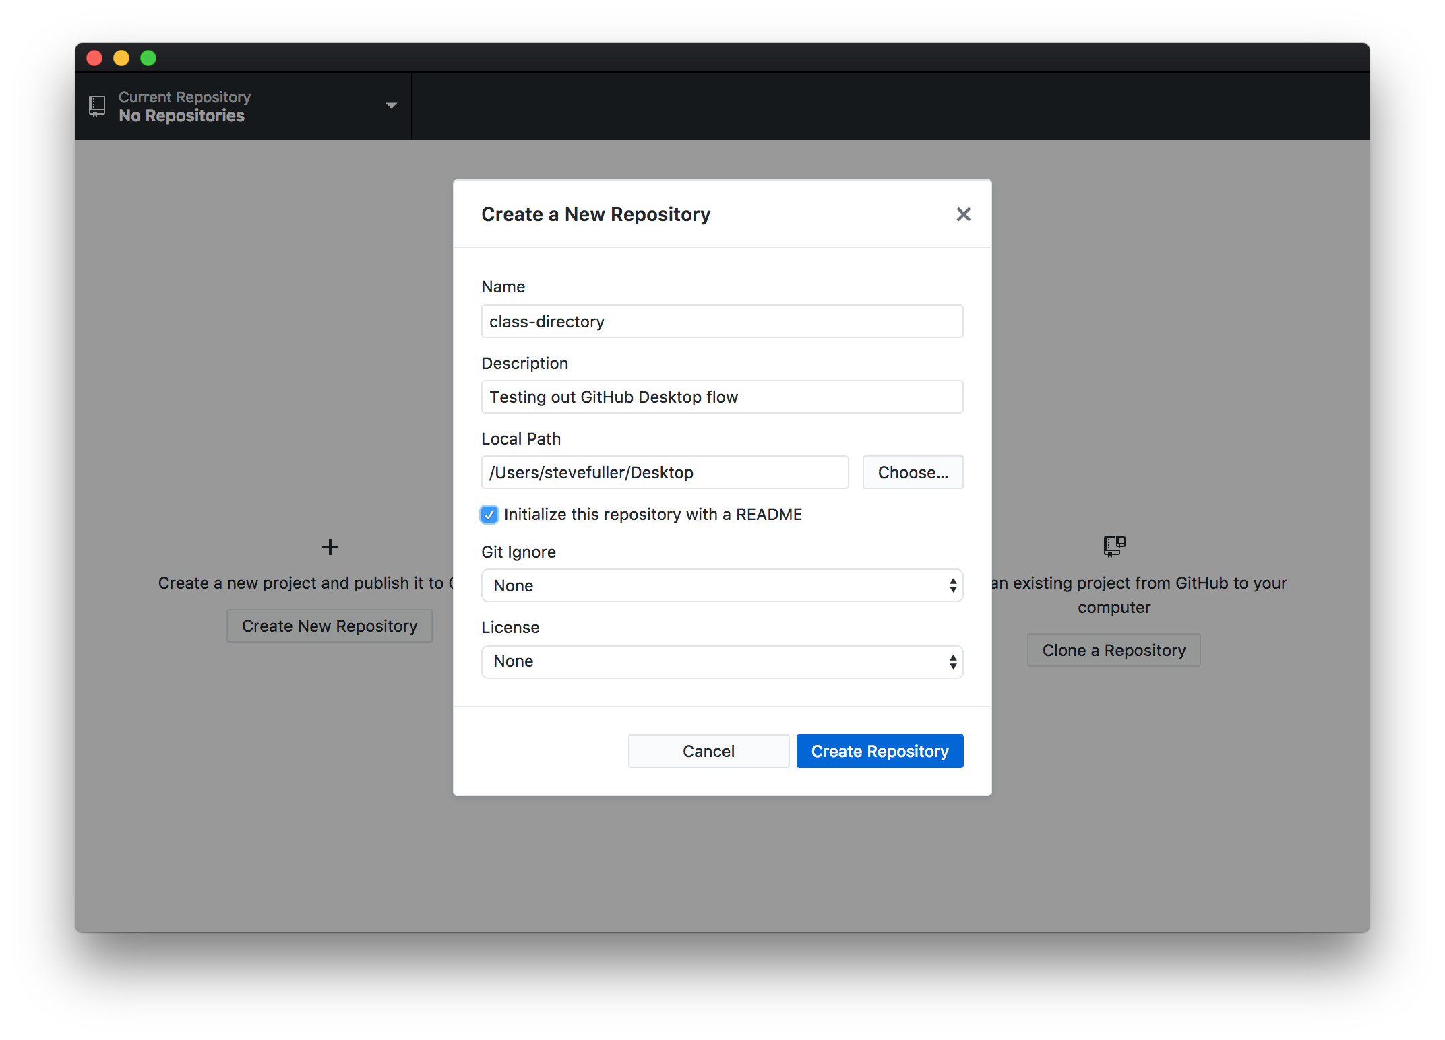
Create a new project
Name your project
Write Description
Where do you want your Repo to reside on your filesystem?
Initialize with README?
A README is information about your project like installation instruction(s), how to use, FAQs, etc.
Git Ignore
Files you don’t want in GitHub
License
Copyright protections
Creating this will create a new folder with your essential Git files

Slide 30
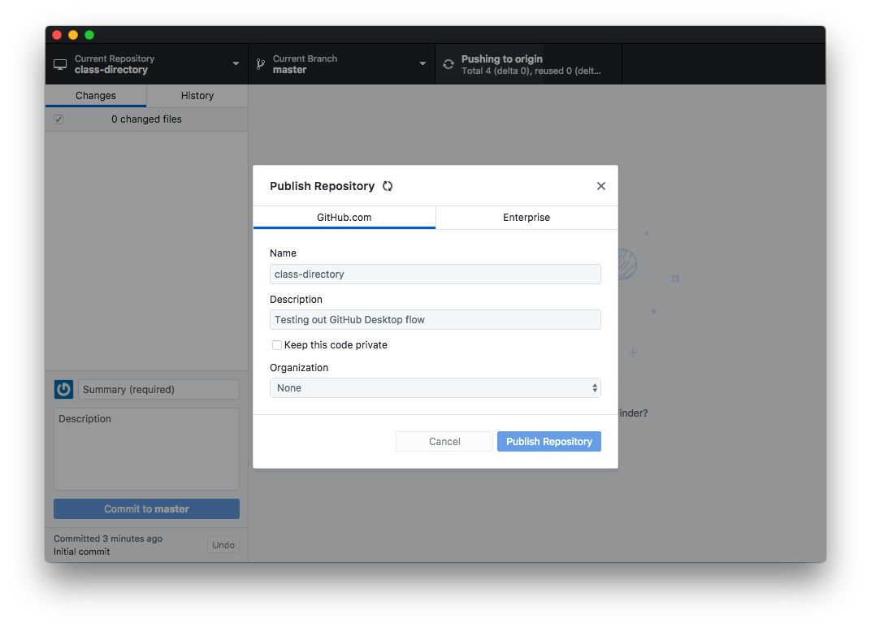
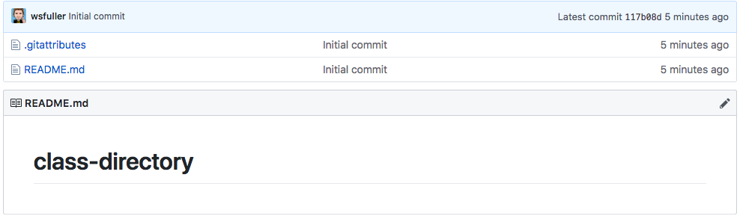
Publish Repository
In the top right corner press “Publish Repository”
Now go to: github.com/:username/:repo-name
And you should see something like:

Slide 31

Congratulations you’ve just published to GitHub!!!

Slide 32

But like, where’s my code and stuff?!?!

Slide 33
One more thing… the .gitignore file
.gitignore is a file we use to omit certain files from being submitted to GitHub
macOS gitignore
Windows gitignore
Here are a couple basic files that should cover our needs. For example though you don’t want to be committing things like .psd, .sketch, etc files into GitHub. The .gitignore should always be updated before for code commits to avoid any unnecessary files from accidentally being committed.

Slide 34
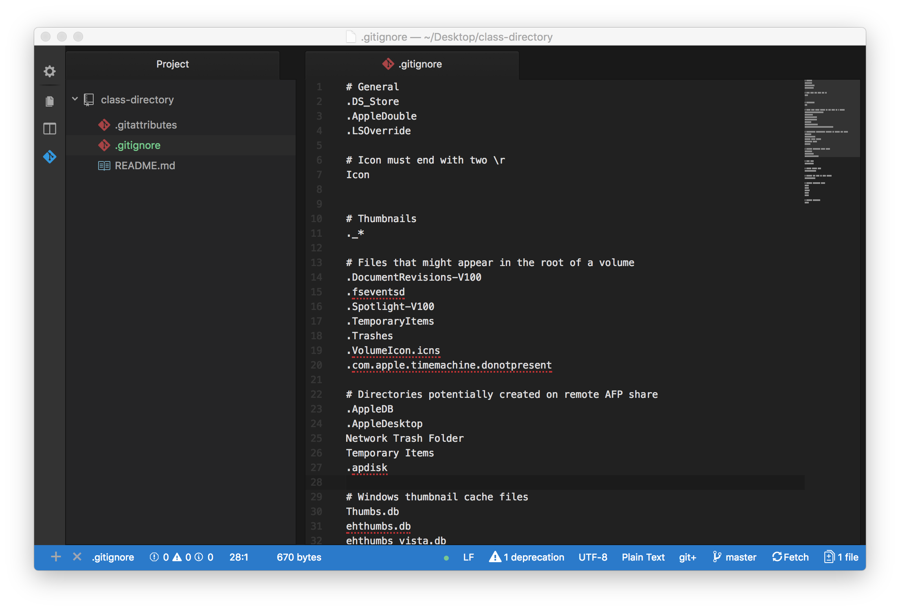
Adding your .gitignore
Open up your GitHub folder that was created in Atom
Make a new file called “.gitignore”
Paste in the sample code from the previous slide links
Commit this new file to your GitHub repo

Slide 35
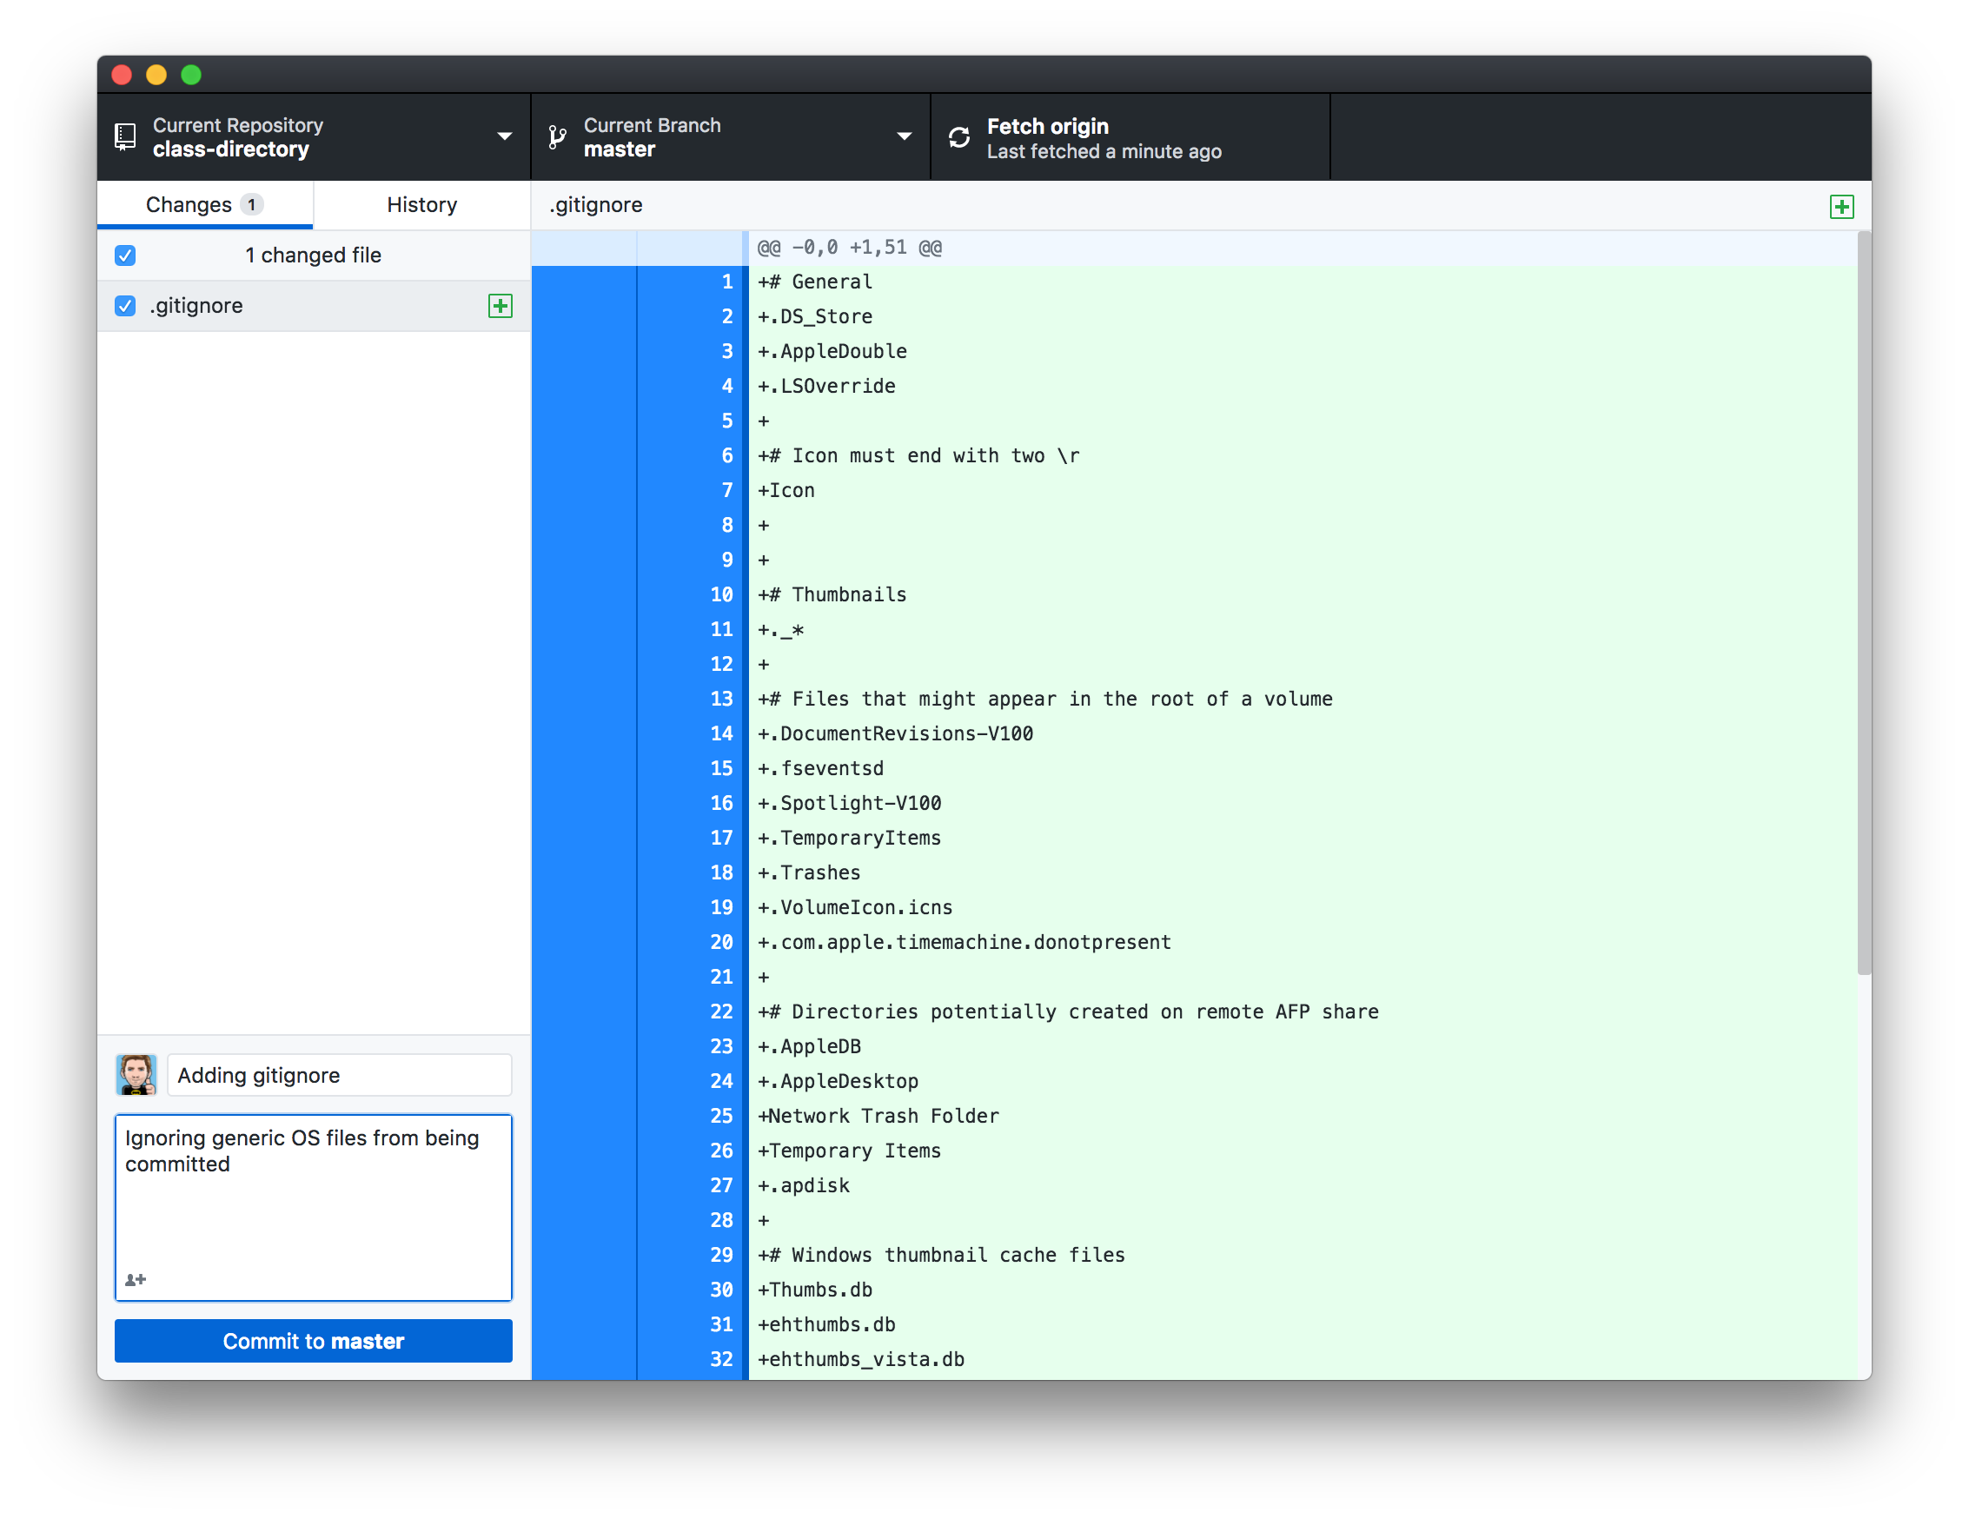
Commit your .gitignore
Open GitHub desktop
Fill out Summary
Fill out Desktoption (optional)
Commit to master
Click Push origin
Visit your repo

Slide 36

You’ve just updated your repo!!!

Slide 37
But like, where’s my code and stuff?!?!

Slide 38
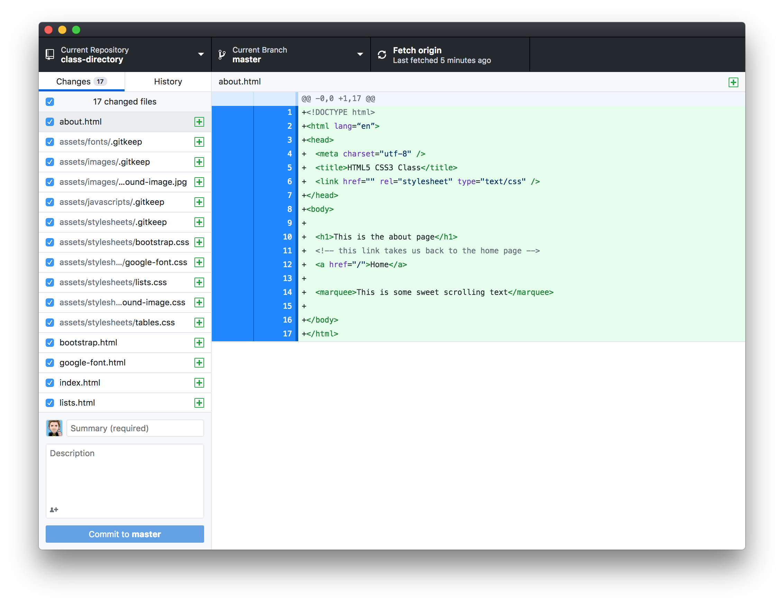
Let’s get our actual code up
All we’ve done is prepare a folder that’s linked to GitHub, there’s a couple more steps to get this all working
Copy your working code into the one you just created for GitHub
Now you should see your files showing up
Summary
Description
Commit to master
Push to origin
Visit your GitHub Repo
Pat self on back

Slide 39

Oh yeah

Slide 40
But we aren’t quite done yet...

Slide 41
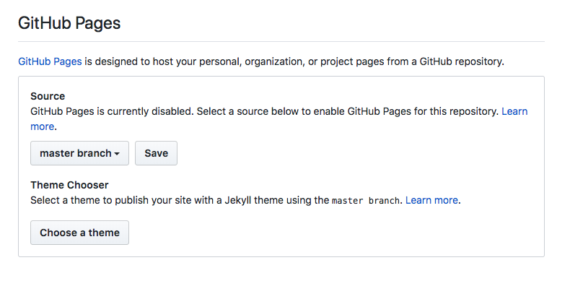
Publish to GitHub Pages
GitHub pages will allow GitHub to take our code and publish a working website for everyone to view
Go to your GitHub Repo page
Click the Settings tab
Scroll down till you see “GitHub Pages”
Source should be your master branch
Click save
You should see a link: “Your site is ready to be published at :URL
Go grab a coffee and should be live in ~30 minutes

Slide 42

Congrats on using GitHub and Deploying your site!!!

Slide 43

Homework
Submit: GitHub URLs (omit this till next week)
URL to your Repo
URL to your GitHub Page
Read
Ch 17 & 18
Code
About Page
Tour Dates

